Slide 1
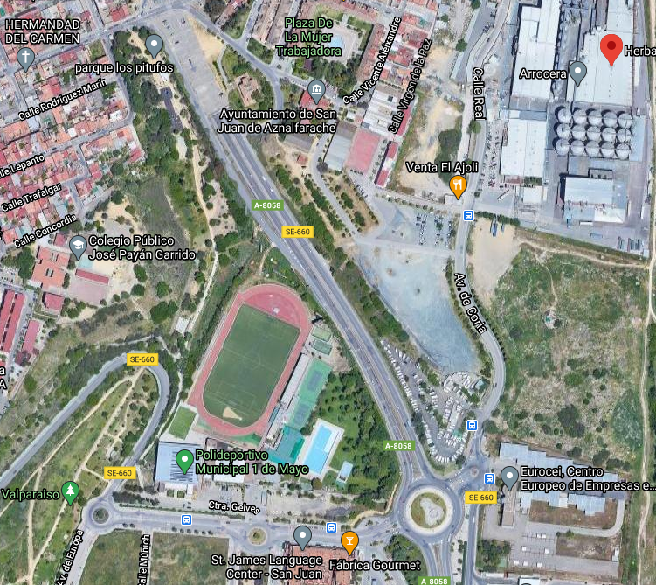
PARKING
PARKING
PARKING
Acceso Peatonal
desde Parking
EXÁMENES

